Slide 1
Mekelle Institute of Technology
Artificial intelligence
Group Assignment
4TH year CSE
Name ID_Number
1.Tsegay G/Slassie mit/ur/113/09
2.Welay Teka mit/ur/114/09
3.Zewde Abadi mit/ur/164/09
4.Zena G/Hiwot mit/ur//09

Slide 2
Introduction
Employee: An employee is an individual who is being hired by the top level management of the organization, through the interview process for achieving the organizational goals and fulfil the needs and wants of the organization.
Employee Performance is a process of calculating or measuring whether the employee executes his job/work at the given time with Accuracy.
It should also include the efficient and effective working of the employee in order to satisfy the organizational goal and to increase their performance.
Employee Performance, lead to the profit maximization and globalization of the organization.

Slide 3

Levels of performance

Slide 4
Benefits of Employee Performance
Some of the advantages are:
Timely course correction.
Easy to track the performance.
Helps manager and employee to interact.
Annual review.
Effective and efficient working.
Profit maximization.
Improved business profit
Increase employee responsibility.
Enhanced quality of work life.
Equitable treatment of employee.

Slide 5
How to Implement Employee Performance?
If you are starting your new business, should bring a proper structure to your firm. The employees are motivated by receiving feedback, about their abilities, capabilities and help them to overcome their weakness.
Some of the mechanisms are:
Should always discuss the various types of performance review with the human resource manager
Utilize the knowledge gained from the human resource manager.
Develop a training program for managers and supervisors.
Convenes all the employees about the performance review.

Slide 6

Contd……

Slide 7
Types of Performance Measures
Objective performance measures
Quantitative count of the results of work
Judgmental measures
Evaluation of the effectiveness of an individual’s work
Personnel measures
Typically kept in personnel file (e.g., absences, accidents, rate of advancement)

Slide 8
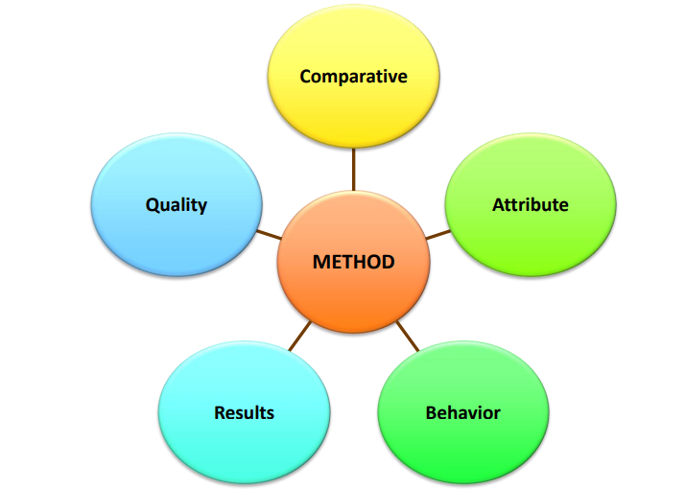
Methods for Measuring Performance

Slide 9
Sources of Performance Information
performance measurement that combines information from the employees’:
Managers
Peers
Subordinates
Self
Customers

Slide 10
The Effect of Training on Employee Performance.
To Improved capabilities, knowledge and skills of the talented workforce
The training programs effect employee motivation and commitment
Through training programs employees recognizes their organization interest in turn apply their best efforts to achieve organizational goals
Through training programs employee show high performance on job.
Through training programs employee are more capable to entertain customer satisfaction and the quality of products and events.

Slide 11
Thank you

